Slide 1
Analytics in Telecom Industry Churn Prediction

Slide 2
Team Members
Gadikota Enavamshi
Soumik Chatterjee
Mohammed Ibrahim
M Sunil
Adarsh Raj

Slide 3
Business Problem/Problem Statement
Tele services reached out to our data science agency asking for help towards a particular problem they would like to solve using analytics.
With the rapid rate at which people are switching their mobile networks, they would like us to predict their customer churn status and help them reduce the same.

Slide 4
Role of Analytics in Telecom domain
Telecommunication market is expanding day by day. Companies are facing a severe loss of revenue due to increasing competition hence the loss of customers.
They are trying to find the reasons of losing customers by measuring customer loyalty to regain the lost customers.
The customers leaving the current company and moving to another telecom company are called churn.
Involuntary churn – Fraud Voluntary churn – our focus where customer switch

Slide 5
Introduction
Project Objective
Predict customer churn
Highlighting the main variables influencing customer churn
Use various ML algorithms to build prediction models, evaluate the accuracy and performance of the model
Finding out the best model for our business case & providing the executive summary

Slide 6
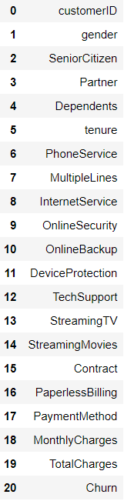
Dataset Description
Content:
Each row represents a customer and each column contains attributes of the customer.
The dataset includes the information about:
Customers who churned into another company.
Services the customers have subscribed.
Customers payment type information.
Tenures of subscription of the services.
And types of customers and a lot more…

Slide 7
Data Preparation
Null values in Total Charges are treated by finding a pattern in the null value occurrence for the customers who have dependents, and no tenure and replaced the mean gender wise
Columns like OnlineSecurity, OnlineBackup, DeviceProtection, TechSupport, StreamingTV, StreamingMovies have categories which can be minimised.

Slide 8
Model Building
Business problem
Data Collection
Data Preparation
Perform EDA, Stats
Validate/
Improve Model
Build Model
Feature selection
Best Model
Solution

Slide 9
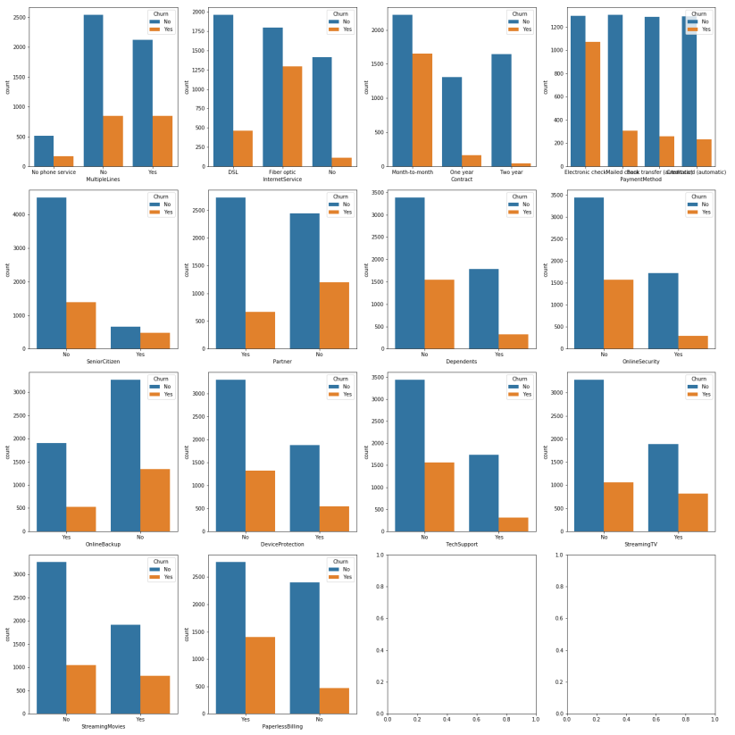
EDA Visuals

Slide 10
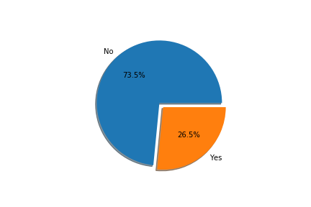
Churn%

Slide 11
With the help of EDA and Statistical tests we choose the variables that influence churn rate Since most of our columns are categorical and we use Chi2_contingency and Proportion Z Test to find the features associated with the churn rate. Features associated with churn:
Feature Selection
MultipleLines
InternetService
Contract
PaymentMethod
SeniorCitizen
Partner
Dependents
OnlineSecurity
OnlineBackup
DeviceProtection
TechSupport
StreamingTV
StreamingMovies
PaperlessBilling

Slide 12
Modelling Pipeline:
Logistic Regression
RFE
Random Forest
Random Forest for best estimators
KNN
Bagging
Gradient
Boosting
Model comparison
Solution
Accuracy check
Accuracy check
Accuracy check
Accuracy check
Accuracy comparison and finding the best model
Selecting required features
Accuracy check
Tweaking the accuracy

Slide 13
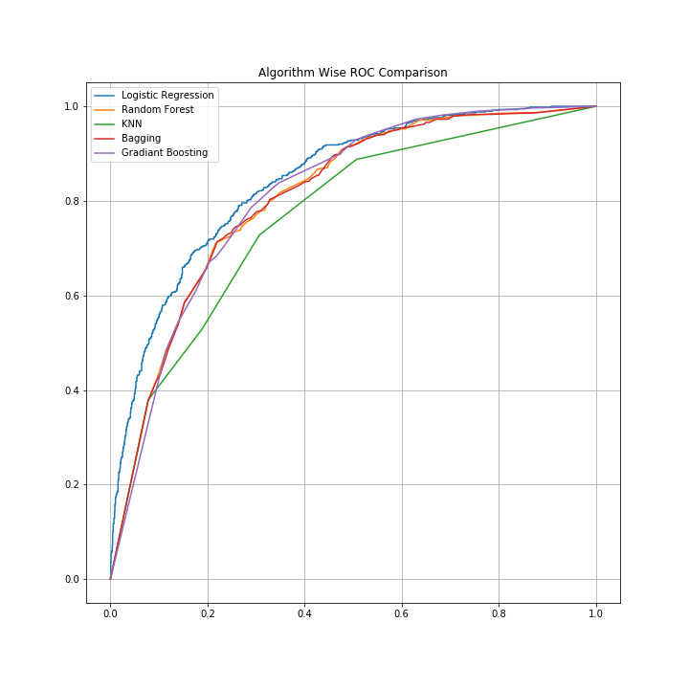
ROC Comparison
Area under the Curve of:- | Value
Logistic Regression | 0.84
Random Forest | 0.81
Bagging | 0.77
KNN | 0.81
Gradient Boosting | 0.81
Area under the curve ~ 1 (Better the model)

Slide 14
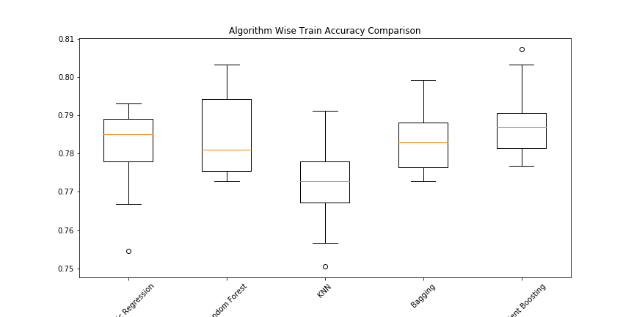
Train Accuracy Comparison

Slide 15
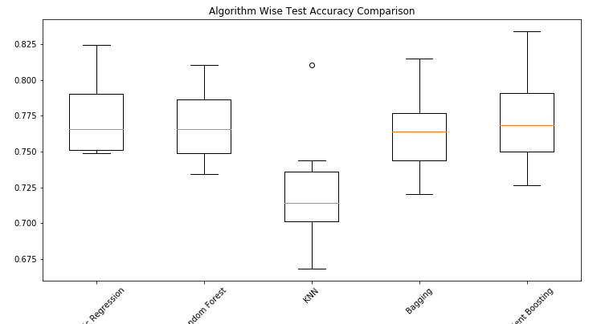
Test Accuracy Comparison

Slide 16
Algorithms | Train Score | Test Score | Performance
Logistic Regression | 0.781339 | 0.773310 | Better
Random Forest | 0.784381 | 0.769047 | Good
KNN | 0.772414 | 0.721260 | Good
Bagging | 0.783367 | 0.764310 | Good
Gradient Boosting | 0.788641 | 0.773793 | Best

Slide 17
Factors Affecting Churn
Multiple Lines (industrial)
Internet Service
Contract years
Payment Method
Online Security
Tech Support

Slide 18
Proposed Solutions
Retaining commercial customers with special prices
Providing better Internet Services
Long term engagements(Subscriptions)
Attracting Customers towards online payments
Provide good online security with better offers
Provide good technical support

